Slide 1

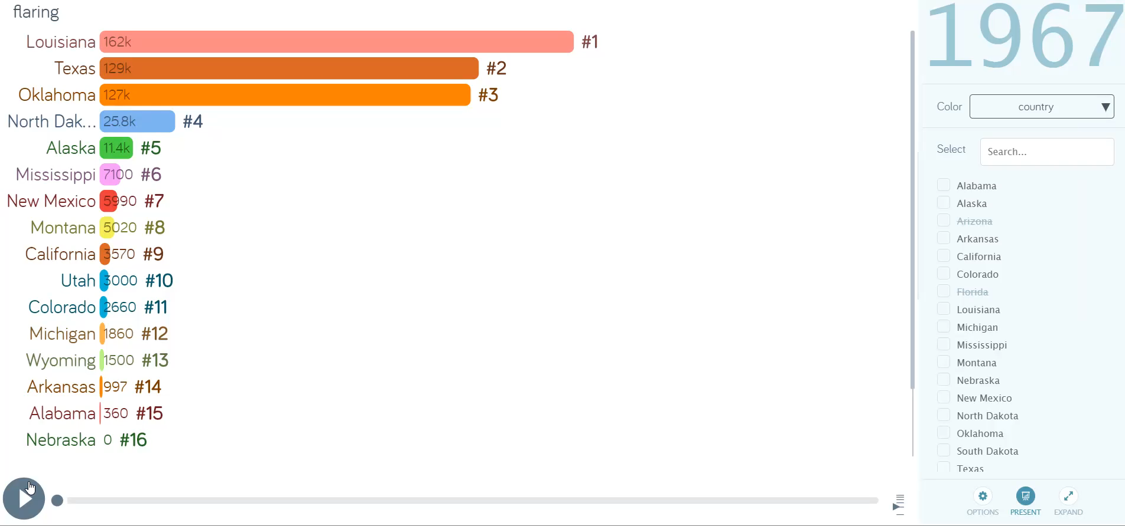
CPTS 575- Data Science| Semester Project Presentation
Notes:
V

Slide 2
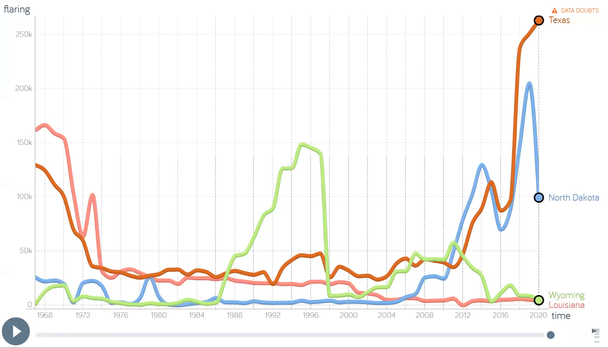
CPTS 575- Data Science| Semester Project Presentation
Used Gap minder software

